Slide 1
How to Get Job at Oil & Gas Industry
A Fit
Ingelora Loudia Anggita
Saka Energi Indonesia

Slide 2
A minute on safety!

Slide 3
Hello!
I am Ingelora Loudia Anggita
MBA from SBM ITB
HR practitioner in Oil & Gas industry
LinkedIn: Ingelora Loudia Anggita

Slide 4
OIL & GAS CHALLENGES AND OPPORTUNITY IN THE PANDEMIC SITUATION

Slide 5
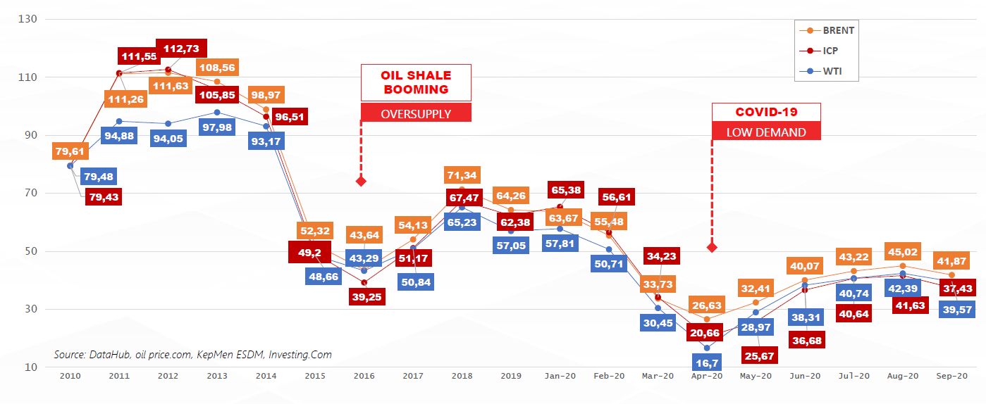
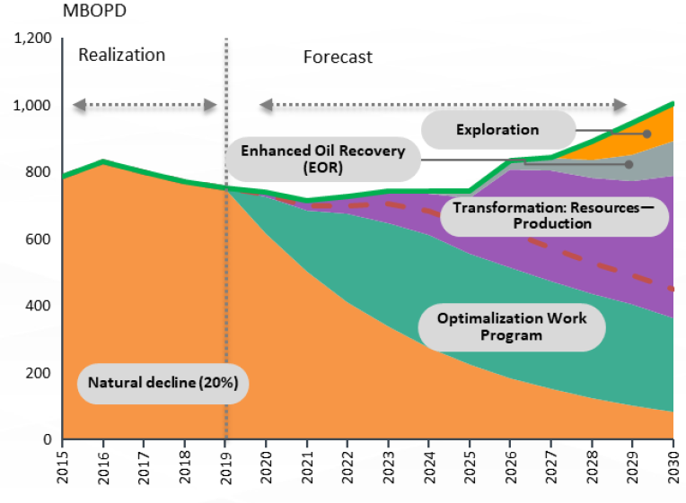
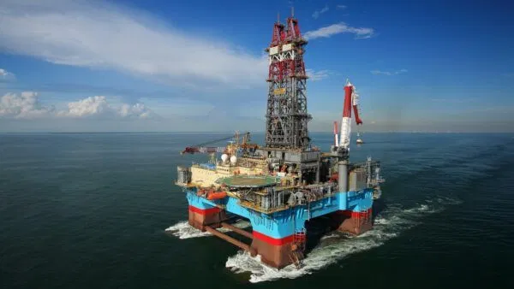
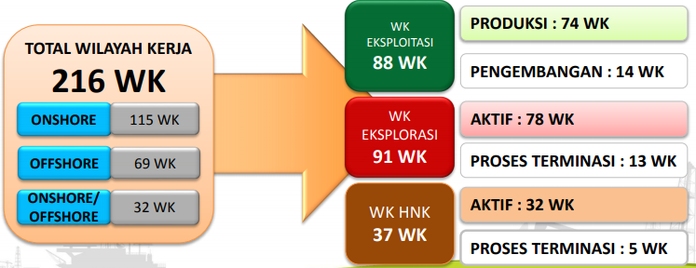
PROFILE CRUDE OIL PRICE AND PROFILE OIL PRODUCTION IN INDONESIA
Crude Oil Price (USD/Barrel) 2010-2020
PROFILE OIL PRODUCTION INDONESIA
Current challenges in Indonesia: Import ± 750k BOPD crude oil +BBM due to higher national oil demand (1.5 million BOPD) than national production (750k – 780k BOPD). Data December 2019
High Cost
Source: SKK Migas, 2019
High Risk
High Technology

Slide 6
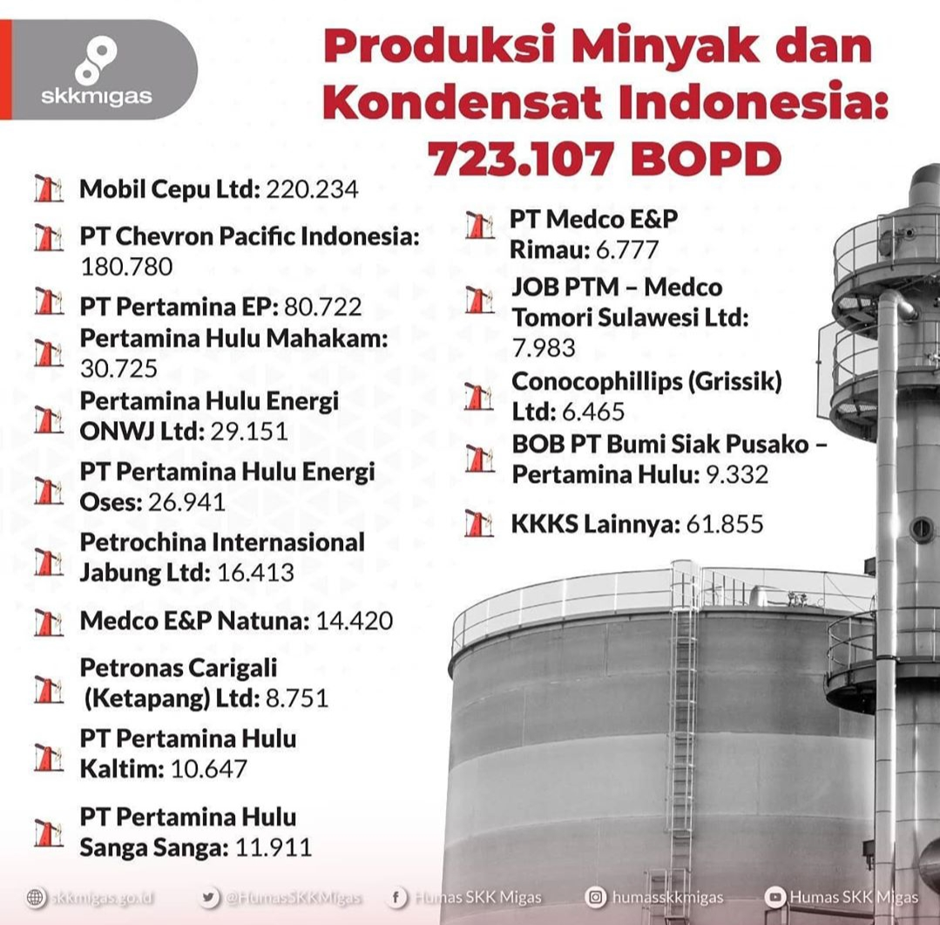
OIL AND GAS PRODUCER (KKKS) IN INDONESIA
Data per May 2020

Slide 7
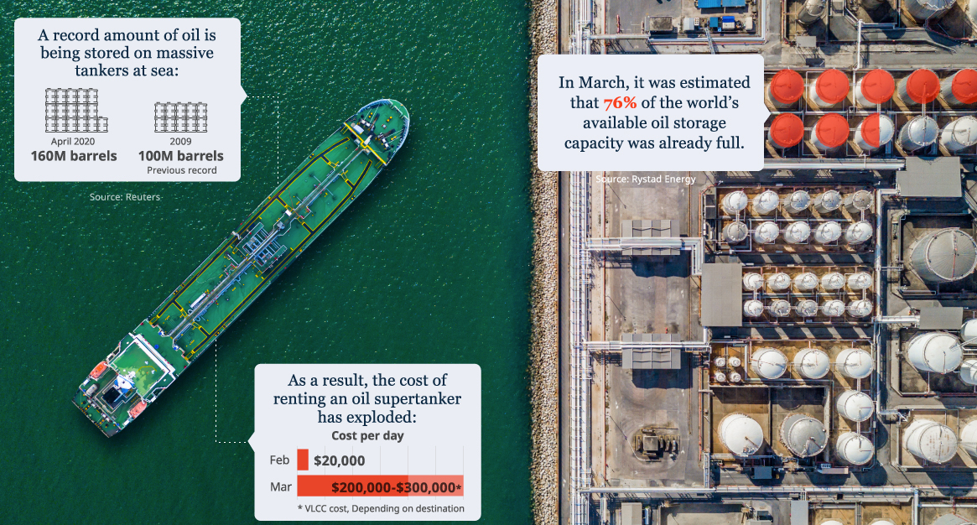
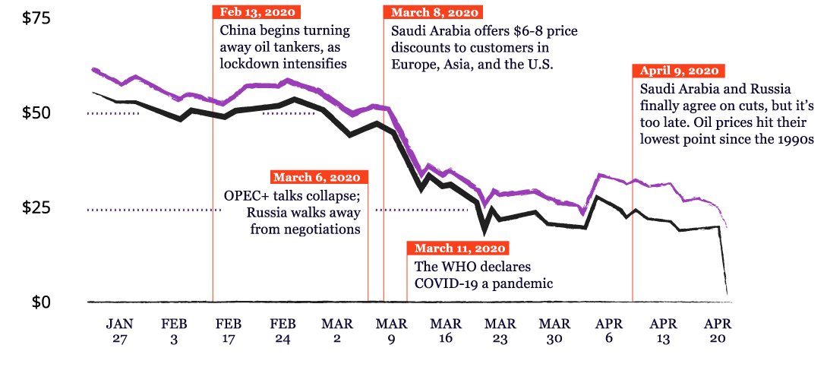
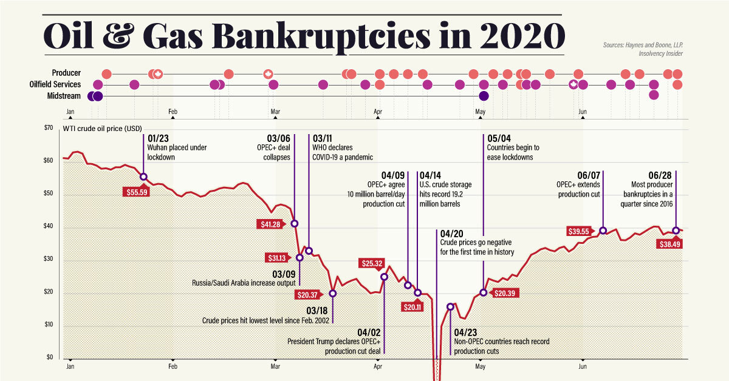
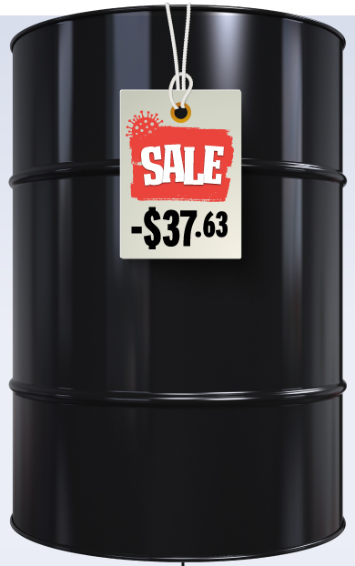
THE PANDEMIC COVID-19 OIL CRASH

Slide 8
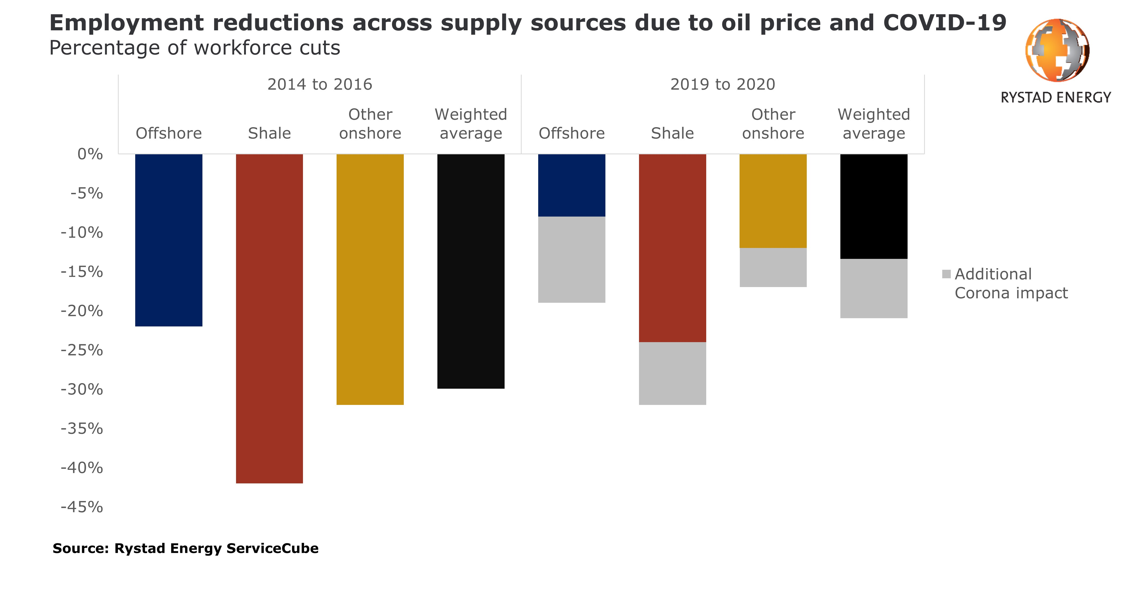
THE IMPACT TO OIL AND GAS INDUSTRY DUE TO PANDEMIC COVID-19 (WORLDWIDE)
Total Labor force: 3,500,000,000
Directly employed by Oil and Gas Industry: 6,000,000
Indirectly created by the industry: 60,000,000
Indonesia labor force: 125,000,000
Indonesia Oil & Gas and Mining: 21,385,000
Source: Data World Bank

Slide 9
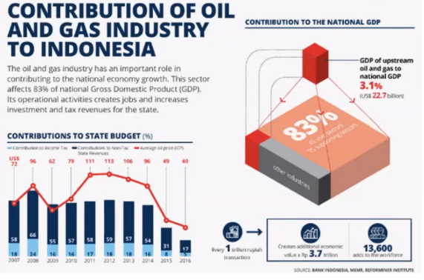
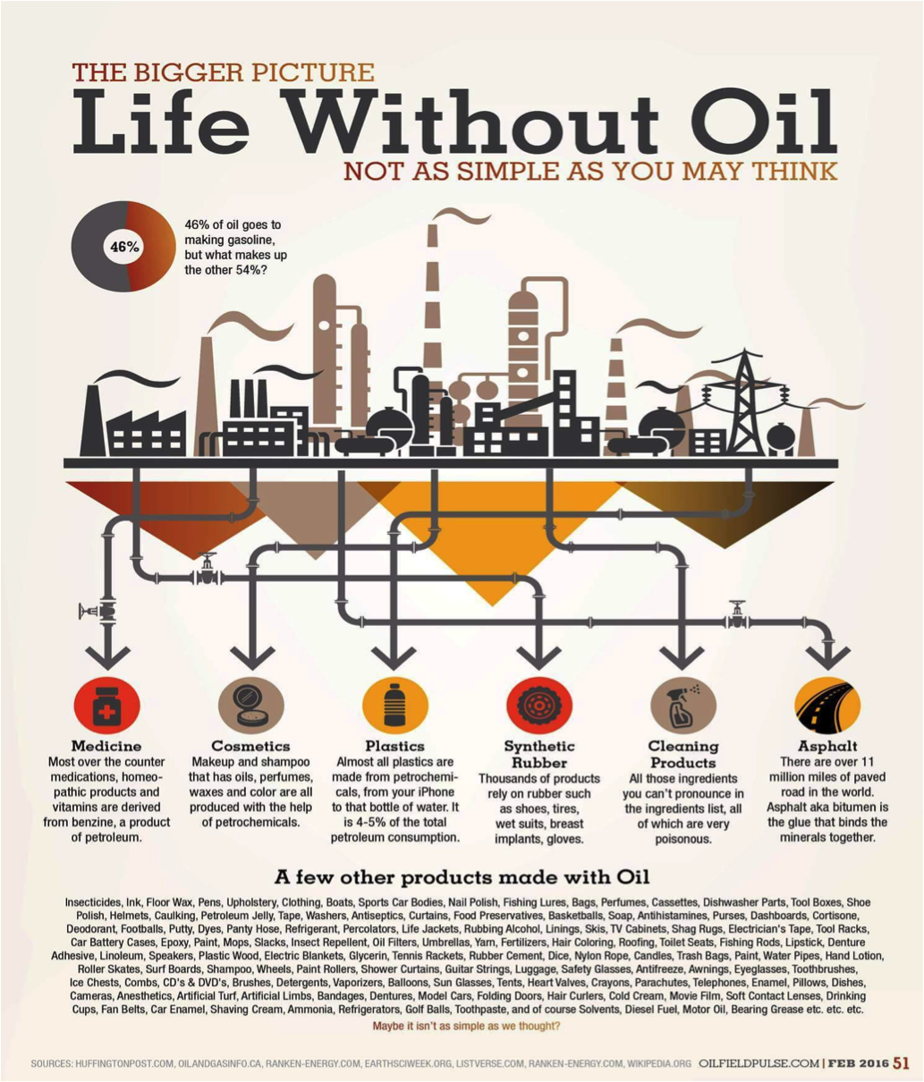
CONTRIBUTION OF OIL AND GAS INDUSTRY TO INDONESIA

Slide 10
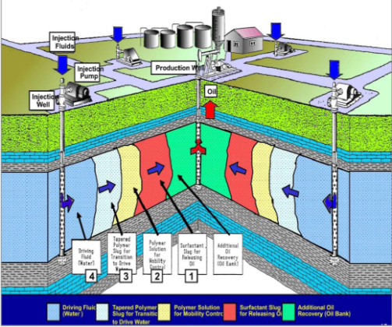
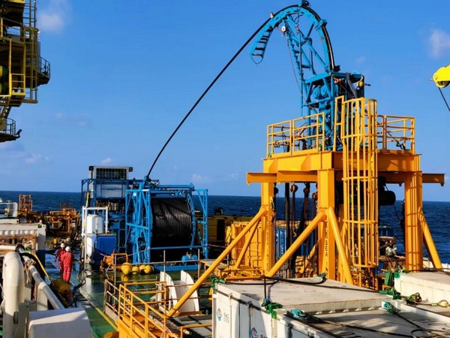
STRATEGY OF GOVERNMENT TO ACHIEVE 1 MILLION BOPD BY 2030
Source: SKK Migas, 2020
Menjaga keandalan fasilitas produksi, maksimalisasi kegiatan kerja ulang dan perawatan sumur, reaktivasi sumur tidak berproduksi dan inovasi teknologi
Mengakselerasi monetisasi proyek-proyek utama, sehingga mempercepat potensi sumberdaya menjadi lifting
Mendorong dan mengampanyekan penerapan EOR di lapangan tua (mature)
Mengedepankan Strategi Explorasi yang massif dan intensif

Slide 11
THE FUTURE OPPORTUNITIES

Slide 12
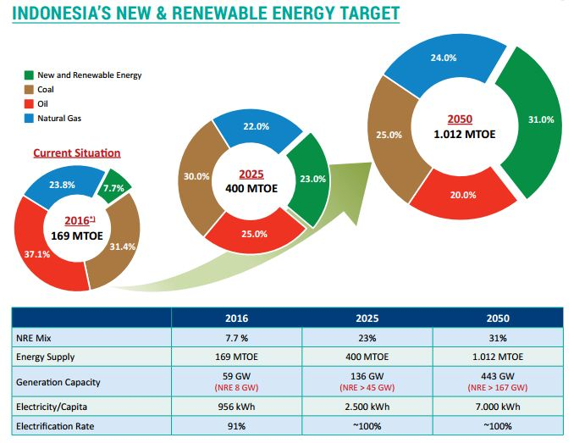
THE FUTURE OPPORTUNITIES

Slide 13
What does the world want?

Slide 14
Be a Perpetual Learner
Only 27% of College graduates are actually going to be working in the field that they major in
65% of graduates are going to have to do a job that hasn’t even been invented yet
What do you want to do when you grow up?
What is your major?
What do you do?
Learn How to Learn
Source: Work to Learn Articles by Heather E. McGowan
Notes:
There used to be a time where graduating from school was enough for you to be successful in life and in work. ⁣⁣And when you worked for a company, it too, would teach you everything you needed to know.⁣ ⁣ But today, that’s no longer the case.⁣ ⁣ Today, you can't rely on educational institutions and companies to teach you everything you need to know to be successful. ⁣ ⁣ You need to be more accountable over your personal and professional development. ⁣ ⁣ You need to learn how to learn.⁣ ⁣ Especially in this rapidly changing world of work, you’ll likely need to reinvent yourself multiple times during the course of your career. ⁣ ⁣ What do you do to keep learning?⁣

Slide 15
THE FUTURE OF WORK IS GOING TO BE ALL ABOUT CREATING THE LADDER FOR YOUR SELF
Notes:
Learning how to learn is the new currency for the future of work

Slide 16
3 STEPS TO IMPLEMENT
“FUTURE BACK” THINKING
01
Develop an inspiring vision
02
Translate in into a clear strategy
03
Prepare for and manage its implementation

Slide 17
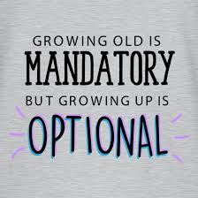
GROWING UP WITH HYDROCARBON SELF DEVELOPMENT
True experience of Harry MAC – Direktur Perencanaan & Pengembangan PT ASDP Indonesia Ferry (Persero)
Source: SDM Naik Kelas!, Antoni Ludfi Arifin, dkk
Notes:
Learning how to learn is the new currency for the future of work

Slide 18
Head
Honest
Heart
Competence
Chemistry
C2H6
Hand
Humble
Humor
01
02
Competence
Head
Heart
Hand
Chemistry
Honest
Humble
Humor

Slide 19
WHERE TO FIND JOB VACANCIES?

Slide 20
What does
the company want?
Study the job post and learn what kind of person the position needs. Keep in mind the company's principles and goals while evaluating every potential employee.

Slide 21
Interviews are nerve-racking.
No matter how many times you've gone through it, the thought of being interviewed can still make you feel nervous.

Slide 22
What makes a great interview?
The key is to be fully prepared

Slide 23
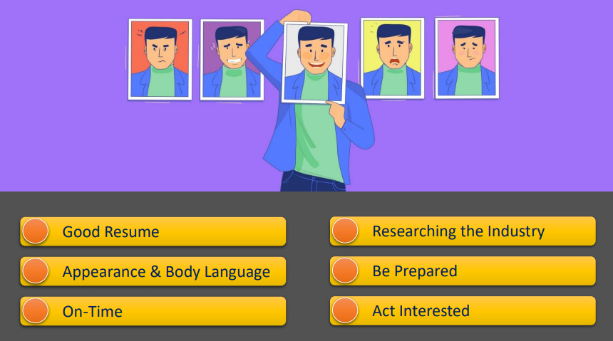
First Impression

Slide 25
Answer truthfully.
If you're applying for a job, you've got to be honest
about yourself and
your background.
Let the interviewer know
your strong points, but be truthful when they ask about your weak points.
Everyone's trying to sound impressive. Your best bet is to be as honest and genuine as you can possibly be.

Slide 26
Be yourself.
Nothing beats being your true self.
Stand out.
It may sound like lame advice, but being yourself helps you shine in a unique and memorable way.

Slide 27
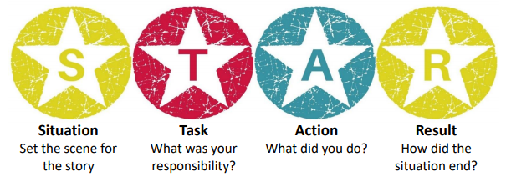
STAR Technique

Slide 28
Keep in contact.
Do not forget to leave your contact details with the interviewer.
Some companies are incredibly busy, so let them know you're still very much interested by asking about your application after some time.
But don't overdo this. Employers will get back to you sooner or later with results. Give them enough time to evaluate you and other applicants.

Slide 29
Be grateful for the opportunity.
Being turned down doesn't dictate
your worth as an employee.
01
Turn this into a learning opportunity and do better in the future.
02

Slide 30
To Win Your Job Interview Journey
Be Prepared
Start with end in mind, proactive, make connection & networking.
01
Focus
Knowing your gap, analyze the position and skills needed
02
Keep Try
Just because something isn’t happening for you right now, doesn’t mean that it will never happen. Keep going and your time will come.
03

Slide 31
Stay true to yourself.
In the span of your career, you'll be given plenty of opportunities to express yourself. Put your best foot forward and show why you're a great person to work with.

Slide 32
Creating Your Own Pathway for Success
The path to success requires you to commit
- DeVon Franklin-

Slide 34
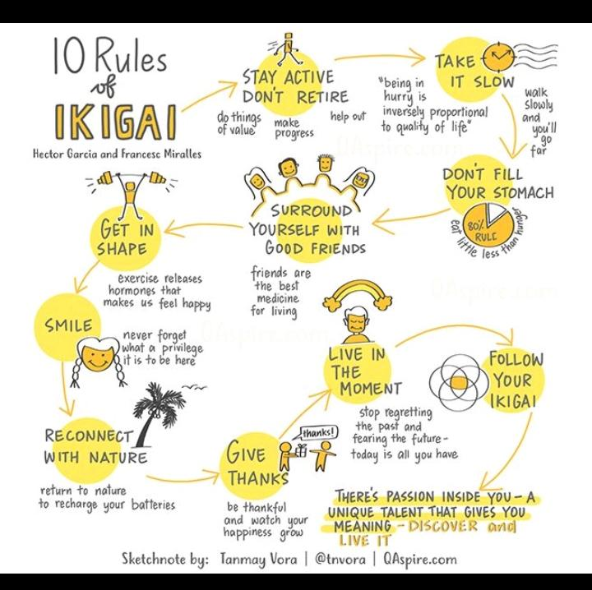

Slide 35
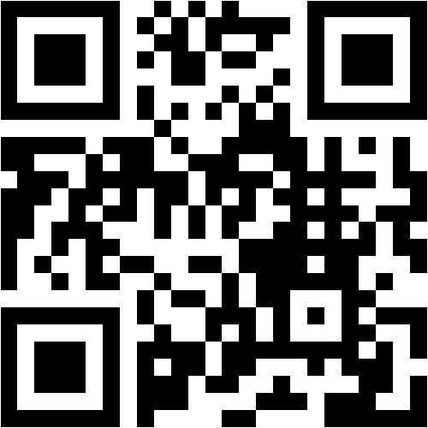
www.menti.com
The voting code 76 48 83
Scan the QR Code

