Slide 1
Programming for Kids – How to make coding fun
Explore tools, techniques and ideas to inspire fun and creativity in your children's approach to programming.

Slide 2
Personal Profile
My name’s Yuki Buwana
Working at Ebiz Cipta Solusi as Java and Mobile Manager
My Phone – 081910000753
My Email – yukibuwana@gmail.com

Slide 3
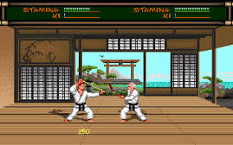
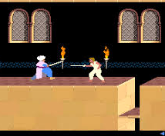
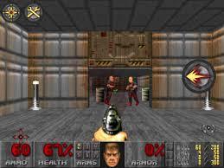

Slide 4
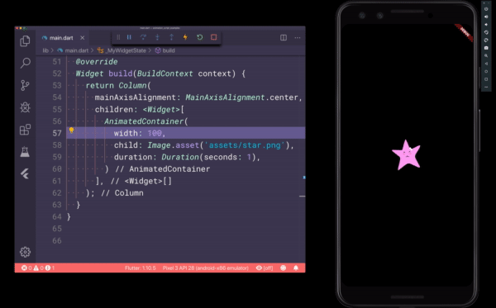
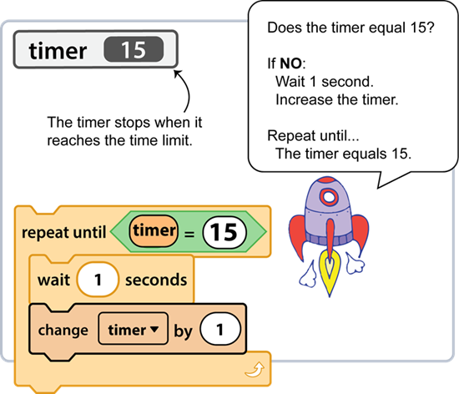
Setting Our Expectation
For Parent
Block Coding vs Text Coding
Give challenges to our children
For Kids
Ages 5 to 7 – Simple Block Coding
Ages 8 to 16 – Block Coding
Ages up to 17 - Text Coding

Slide 5
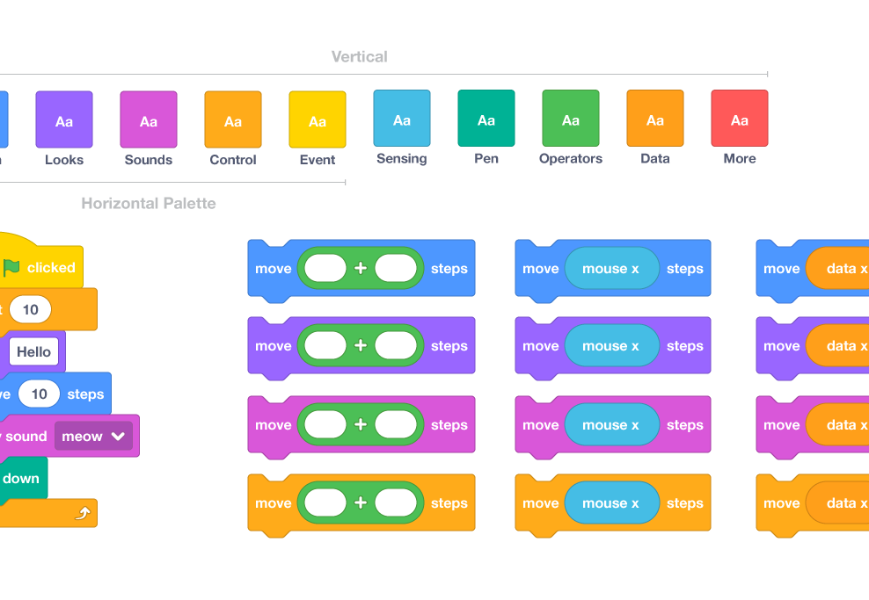
Tools – Block Code
Exercises for Beginner
https://www.getsetkode.com/
Web Programming
https://scratch.mit.edu/
Mobile Programming
https://appinventor.mit.edu/

Slide 6
About Scratch
With Scratch, you can program your own interactive stories, games, and animations — and share your creations with others in the online community.

Slide 7
About App Inventor
MIT App Inventor is an intuitive, visual programming environment that allows everyone – even children – to build fully functional apps for smartphones and tablets.

Slide 8
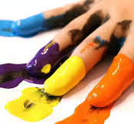
Let’s get our hand dirty
Scratch and App Inventor

Slide 9
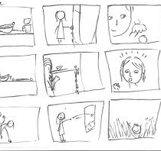
Techniques
Preparation
Idea
Storyboard
Image assets
Implementation
Platform (Web/Mobile)
Tools
Monetize

Slide 10
Coding just tools, essentially it’s about to be a better problem-solver

Slide 11
Thank You
Any Questions ?

